Slide 1
CyberSec Bootcamp Lecture - 0x01

Slide 2
Topics to Covered
Installation of Kali Linux
Basics Commands in Linux
Text Manipulation
Analyzing and managing networks
Adding and Removing Software

Slide 3
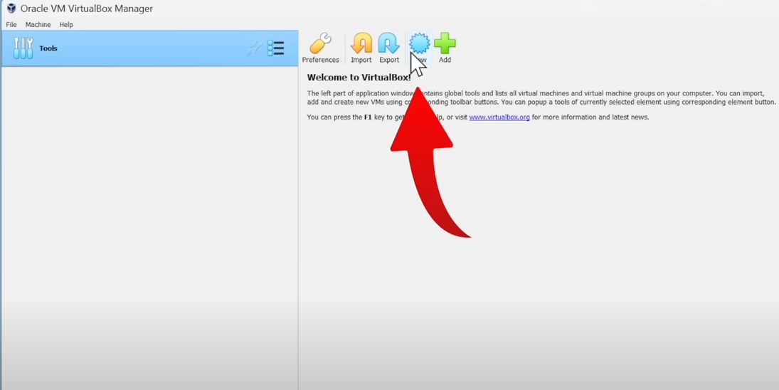
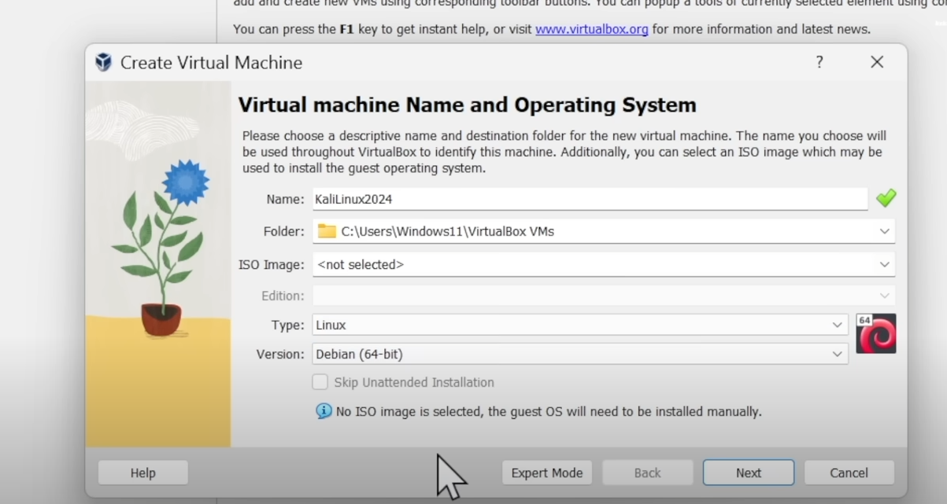
Downloading Kali Linux $> Goto www.kali.org and download the kali iso file (disk image file) $> Goto www.oracle.com and download the VM Virtual Box $> Install the VM Virtual Box and Run it $> Click on the New Button and do the following settings as in below attachments

Slide 4
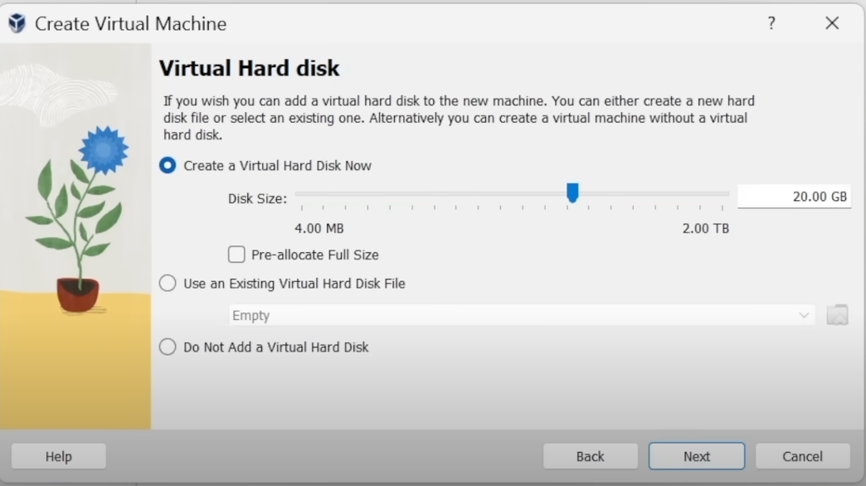
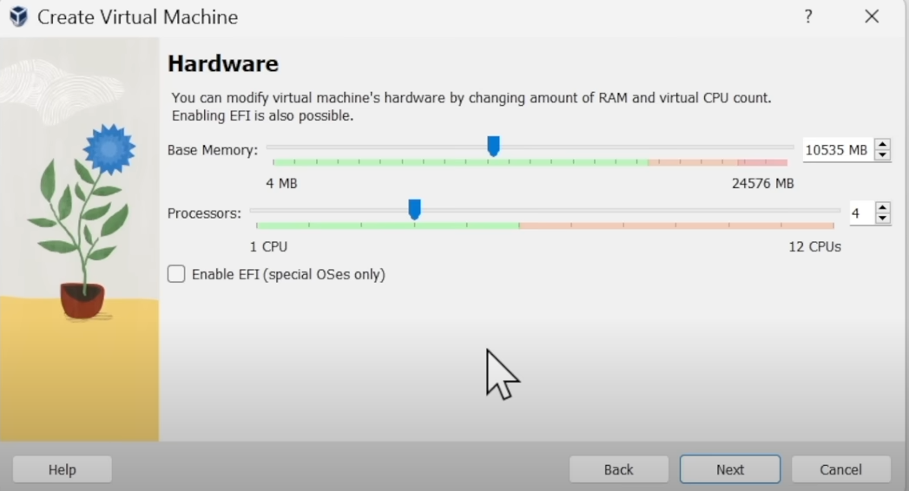
Downloading Kali Linux $> After clicking next allocate RAM, CPU CORE'S and DISK MEMORY to your Virtual Machine according to your system specifications

Slide 5
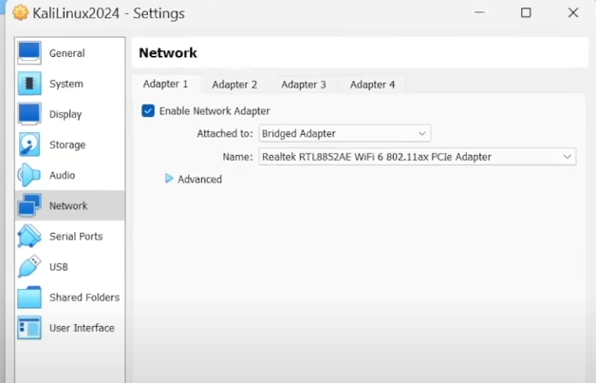
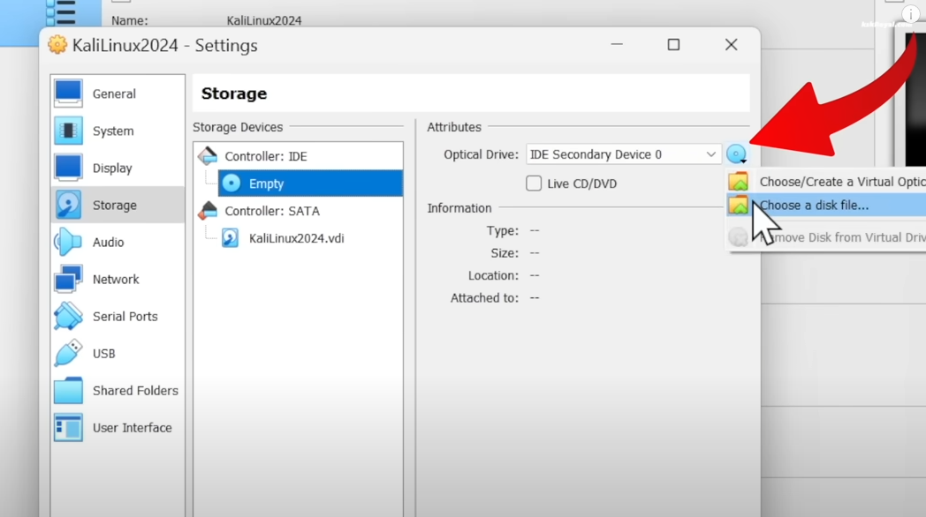
Downloading Kali Linux $> Now our Virtual Machine is ready, click on the Setting button $> Do some general settings as shown in fig. 5 $> Then go to storage, click on the empty disk and then click on the small dvd icon and choose the KALI ISO FILE which we installed initially as shown in fig. 6
fig. 5
fig. 6

Slide 6
Downloading Kali Linux $> Now we are done setting up our Virtual Machine, let's run and install KALI $> Click on the start button and then proceed with graphical installation $> Now select the language, write a username and password and then proceed with default setting's $> when the install GRUB boot loader come select it as yes and choose your virtual disk as installation path $> Wait for few minutes and then our KALI LINUX will be successfully installed

Slide 7
Basic command in Kali Linux $> pwd : tell about our present working directory $> whoami : tell which user is logged in, and if it's a root user or another user $> cd "directory name" : change directory to where we want to go $> ls : list the item's present in the directory $> ls –la : list the item's with more details along with hidden files $> toolname --help or toolname –h : Let us know about basic functionality of the tool $> man toolname : Works as a manual (man) for the tool

Slide 8
Basic command in Kali Linux $> locate toolname or whereis toolname or which toolname : Gives us the location of the tool $> find /directory -type (file type) -name (file name) : find is more powerful command to search for particular files $> grep "filename" : Gives us the file we are looking for $> cat "filename" : Gives the content present in a file (only for reading) $> touch "filename" : Creates a file $> vim "filename" or gedit "filename" : Creates a file which we can edit, save, read and much more $> rm "filename" : Removes a file

Slide 9
Basic command in Kali Linux $> mkdir "directory name" : Creates a directory $> rmdir "directory name" : Removes a directory $> rm –rf "directory or file name" : Remove a directory or a file forcefully

Slide 10
Text Manipulation $> head -number of lines "file name" : Shows the number of desired lines from starting of a file (by default shows first 10 lines) $> tail –number of line "file name" : Show the number of desired lines from ending of a file (by default shows last 10 lines) $> nl "file name" : Assign particular number to each line order wise $> cat "file name" | grep "word" : Display each line which contains the word we used grep on $> more "file name" : The more command display a page of a file at a time and let us page down through it using "ENTER" key $> less "file name" : It is similar to more command with have more functionalities as the saying goes "Less is More"

Slide 11
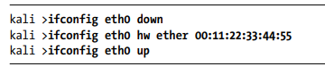
Analyzing and Managing Networks $> ifconfig : To display and modify our network properties such as IP Address, Mac Address etc $> iwconfig : To display and modify the settings of a wireless network interface $> ifconfig eth0 "ip address" : To modify our IP Address $> ifconfig eth0 "ip address" netmask "xxx.xxx.x.x" broadcast "xxx.xxx.x.xxx" : To modify our IP Address, Netmask and Broadcast Address $> To spoof our MAC Address we will first use the command ifconfig eth0 down and then ifconfig eth0 hw ether "MAC Address" and then ifconfig eth0 up as shown

Slide 12
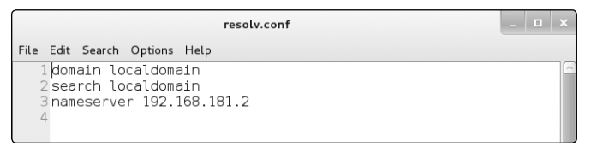
Analyzing and Managing Networks $> dhclient eth0 : To Assign new IP ADDRESS'S from DHCP Server $> dig websitename.com ns : We use dig command to examine DNS of a website, ns is the short form of nameserver $> dig websitename.com mx : We can also use dig command to get information on email servers connected to a domain by adding the mx option, mx is the short form for mail exchange server $> To change our own DNS Server we will use the command "leafpad /etc/resolv.conf" and on the line 3 of the output, we can edit the nameserver and change our DNS by saving it.

Slide 13
Adding and Removing Software $> apt-cache search "package name" : To search for a package $> apt-get install "package name" : To install a package $> apt-get remove "package name" : To remove a package $> apt-get update : To update all the packages $> apt-get upgrade : To upgrade all the packages $> git clone "git hub link of the package" : To install a package from github $> wget "link of package" : To install a package using its link

